Slide 1
Neural Style Transfer
Aneesh Joshi

Slide 2
About me
4th year CSE undergrad
Ex Game Developer
ML Master race
Information Extraction using DL

Slide 3
Goals of this talk
Introduce Style Transfer (duh)
Bring people into the DL master race
Introduce tensorflow as python tools
Provide something not found online

Slide 4
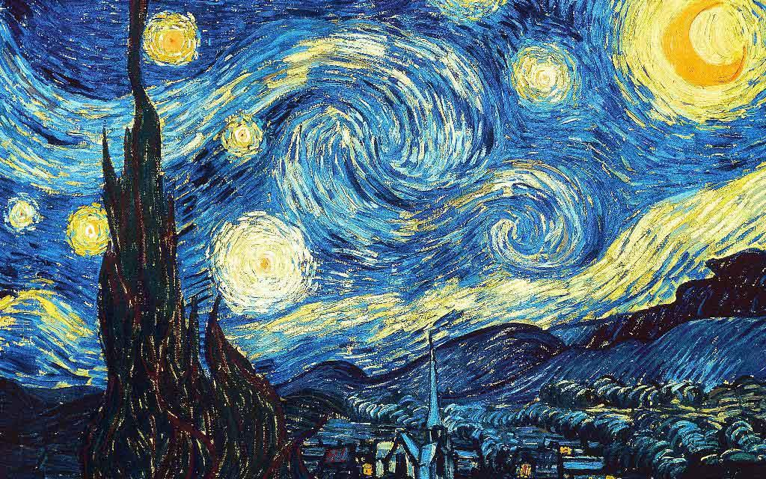
Style Transfer

Slide 5
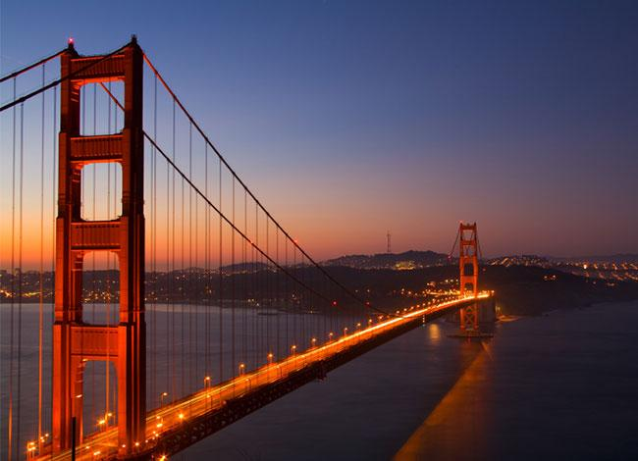
Style Transfer

Slide 6
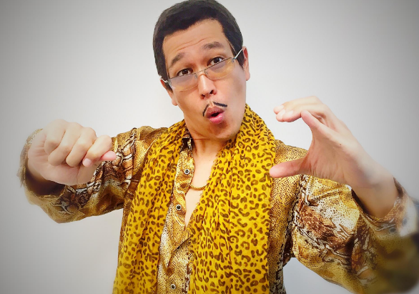
Ugh!

Slide 7
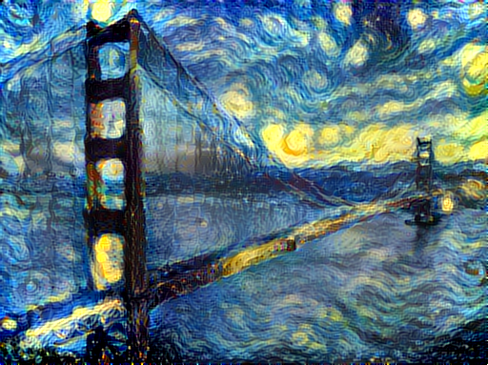
Style Transfer

Slide 8
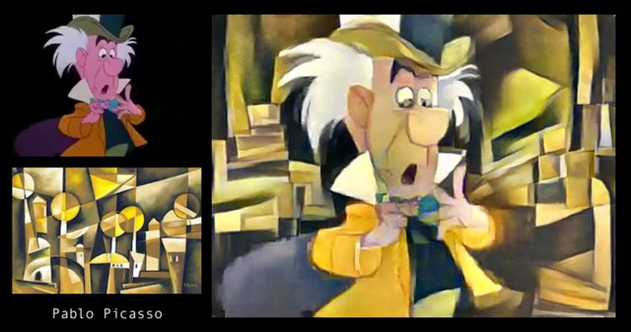

Slide 9
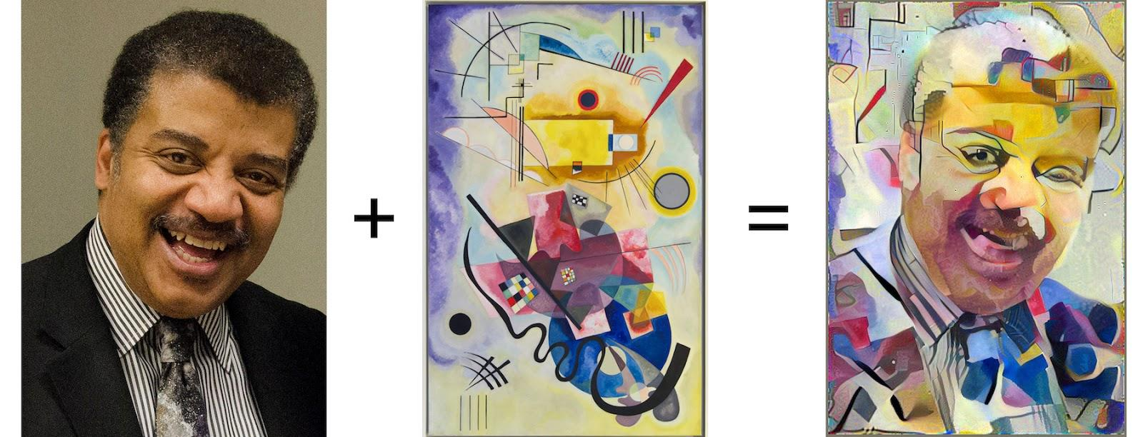

Slide 10
Whoa!

Slide 11

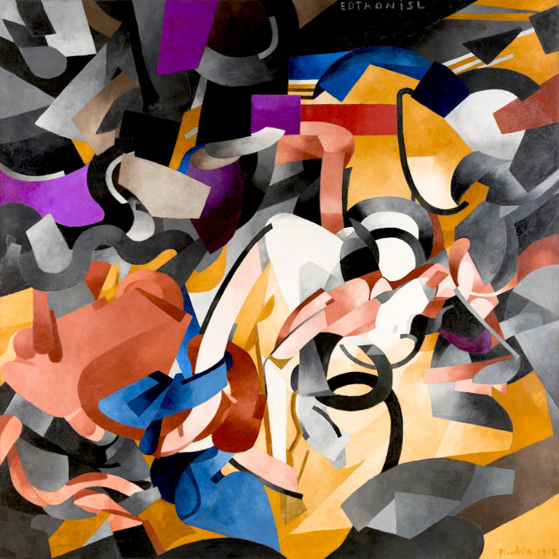
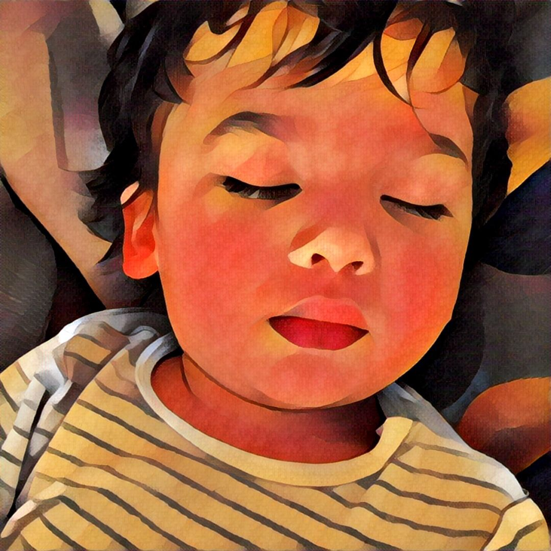
How does one go about this?
Content Image Style Image Combined Image

Slide 14
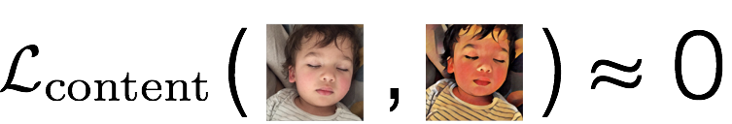

Slide 15
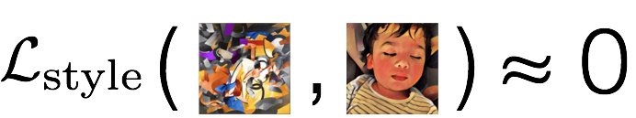

Slide 16
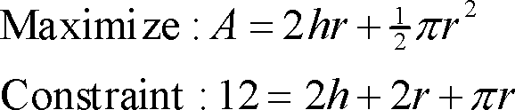
Optimisation
Finding an alternative with the most cost effective or highest achievable performance under the given constraints, by maximizing desired factors and minimizing undesired ones.

Slide 17
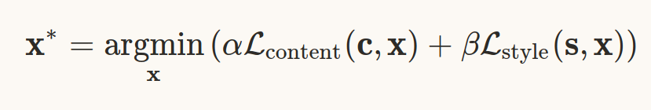
Optimisation
Finding an alternative with the most cost effective or highest achievable performance under the given constraints, by maximizing desired factors and minimizing undesired ones.

Slide 18
Take the average?
No
Will produce bad non-intelligent results
content and style losses are based not on per-pixel differences between images, but instead in terms of higher level, more perceptual differences between them.

Slide 19
We need a system which:
Understands abstract concepts like lines and shapes
Teaching such concepts is difficult mathematically/programmatically
Enter : Deep Learning

Slide 20
Deep Learning would require you to understand:
Neural Networks
Convolutions
Optimisation
And on and on

Slide 21
We don’t have time to go through this
Solution:
Let’s keep it simple.
Look at everything as an optimisation problem

Slide 22
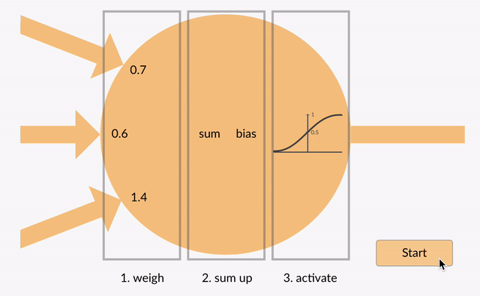
But first, what is a neuron?

Slide 23
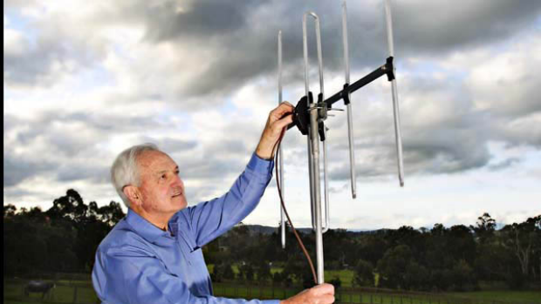
But what are they really?
A parameter wiggler.
It wiggles the parameters
till it predicts correctly
I.e., till the error is minimised.

Slide 24
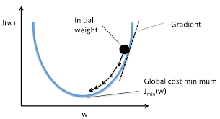
Most importantly:
The neuron decides “by itself” how to wiggle the parameters.
So, we just give it a task and it “figures out” what the correct set of parameters is.

Slide 25
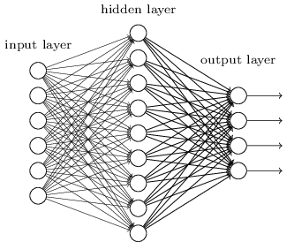
What can a simple parameter wiggler do?
Alone: not much
Combined: A lot!
This combined form is
a neural network
Notes:
Hence name Deep Learning

Slide 26
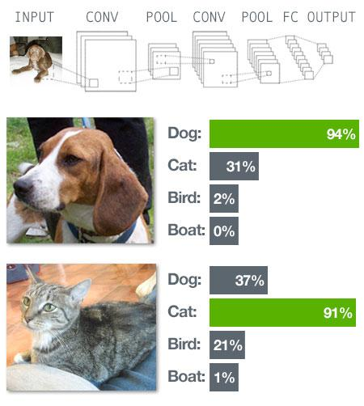
How it works
We give it an input
It predicts an output
We know the correct output

Slide 27

If the output is wrong we get a high error.
We let the network know:

Slide 28
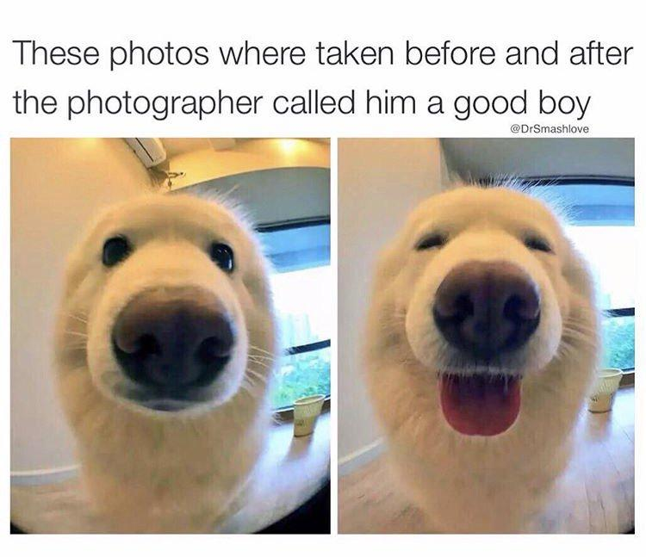
The network feels bad.
It wiggles it parameters to
reduce the error.

Slide 29
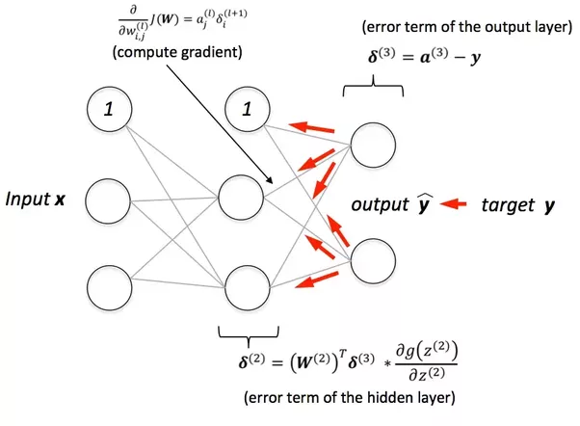
How does it learn the direction to wiggle in?

Slide 30
Framed as an optimisation problem
We want to minimise the error
That’s it.
Let the network decide the rest.
Error: distance between prediction and expected output

Slide 31
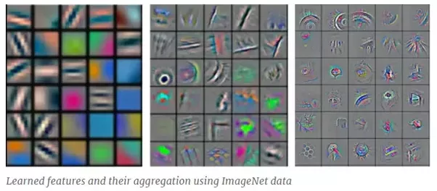
In the process of reducing errors, it learns interesting representations of the input data.

Slide 32
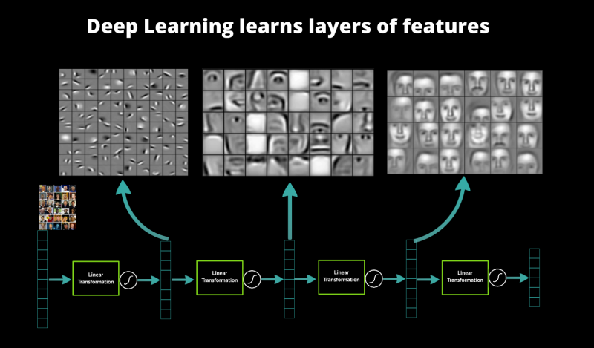
These representations are spread throughout the different layers

Slide 33
It extracts features because they allow it to reach its ultimate goal: to minimise error

Slide 34
Back to Style Transfer!
We don’t care about the predictions for now
We care about the extracted features
They capture abstract ideas like edges and shapes.
Perfect!

Slide 35
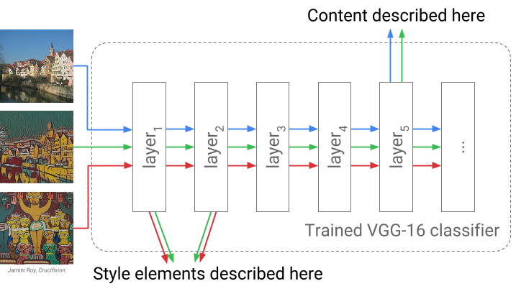
How do features help?
The features give us a way of measuring distance between images
based on features rather than pixels

Slide 36
We now have a way of calculating these losses in a meaningful way

Slide 37
Transfer Learning
For the network to learn features, it needs to be trained on a task.
We could train our own network.
Takes time, data, machines

Slide 38
Transfer Learning
We will use the pre trained VGG16 neural network for our task.
ImageNet Competition
Use 16 layers involved with feature extraction

Slide 39
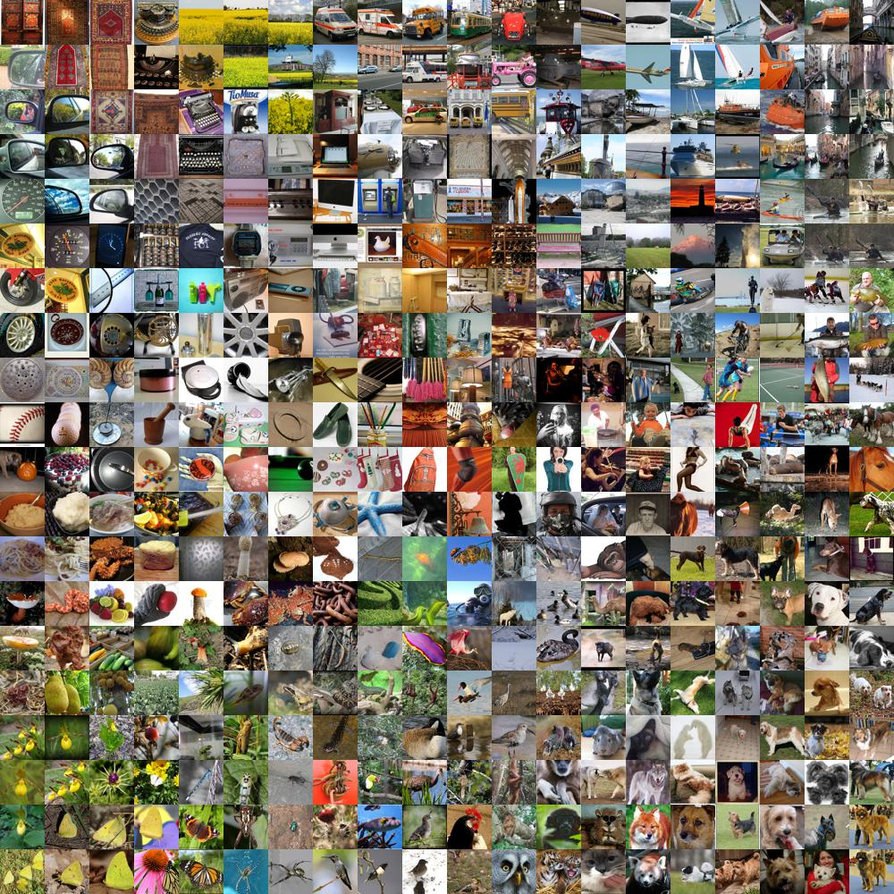
VGG16

Slide 40

VGG16 Architecture

Slide 41
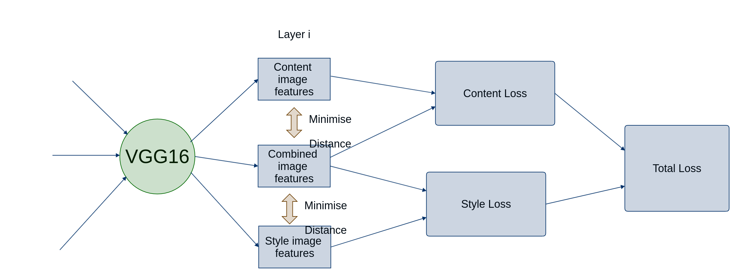

Architecture

Slide 42

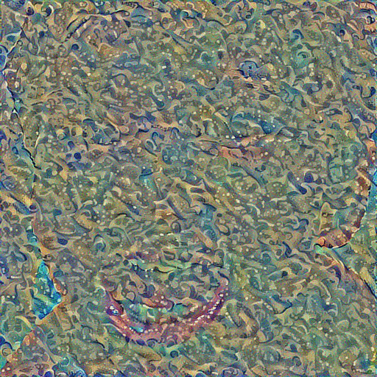
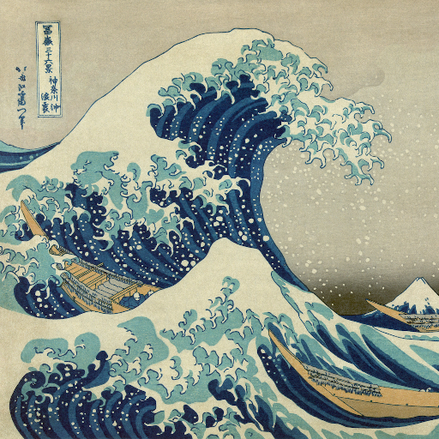
Over several iterations:

Slide 43
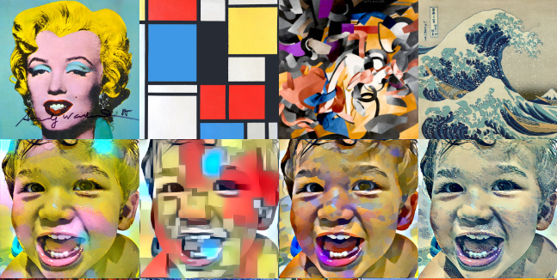

Slide 44

Tying it up with Python

Slide 45

Tying it up with Python

Slide 46
Thank you!

